Slide 1


Unit 2

Slide 2
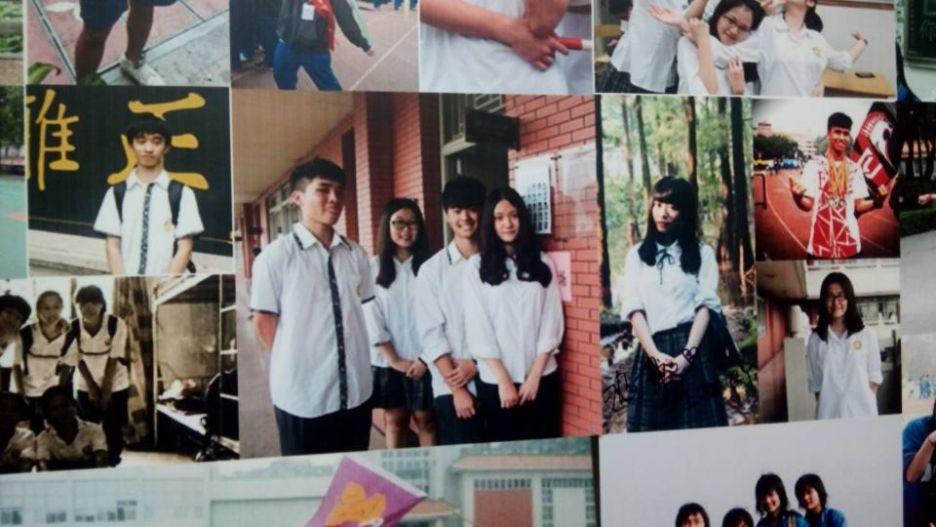
Warming up game~~
Photo Wall

Slide 3
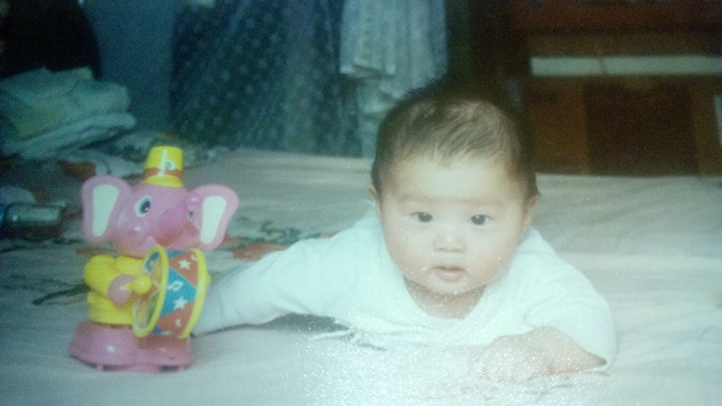
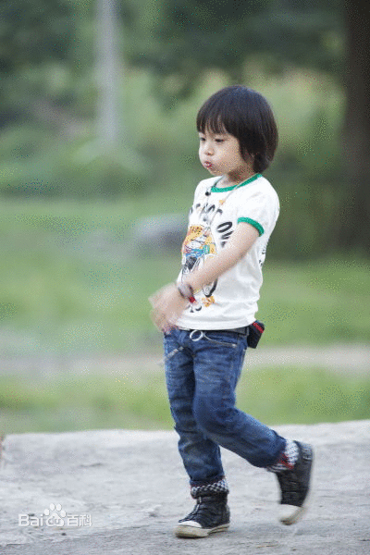
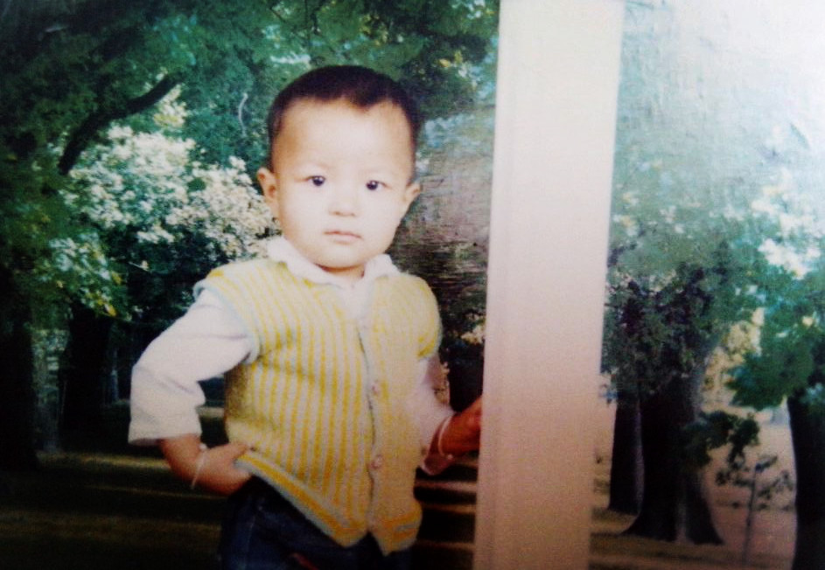
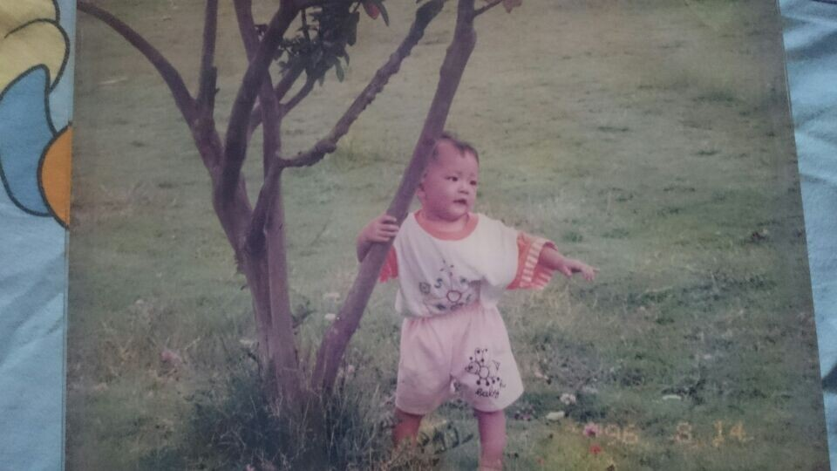
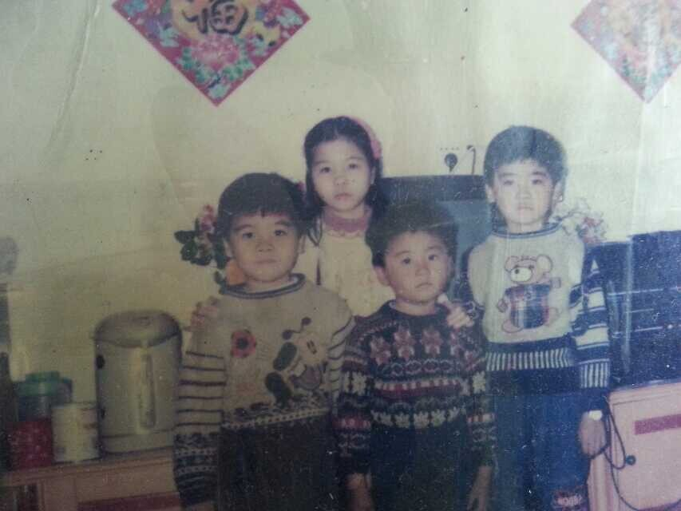
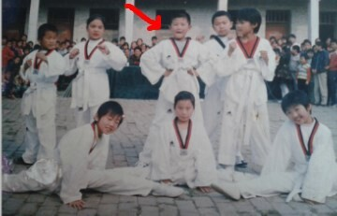

Slide 4
Part 1
entertainments

Slide 5
The cartoon series

Slide 6

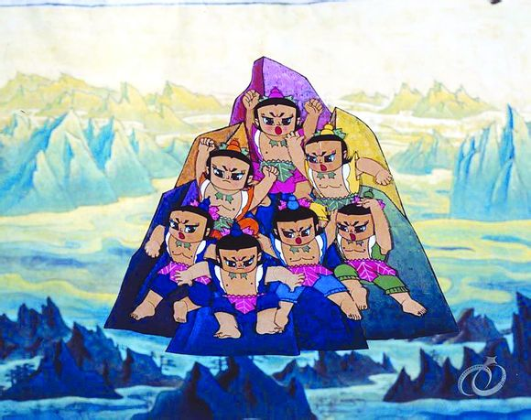
In the 1980s the series was one of the most popular animation in China. It gave us a nice childhood,I am sure that there was a time when our idol was seven little guys but not a superman!

Slide 7
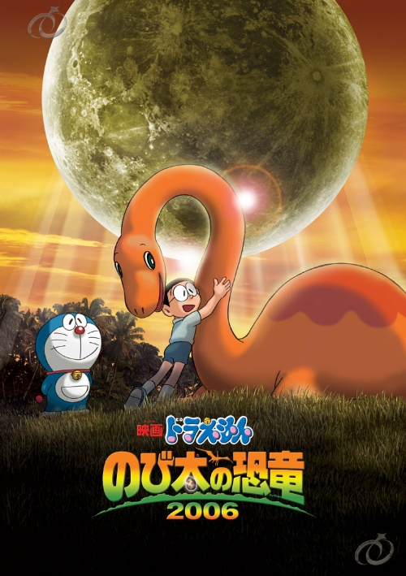
Doraemon
This story revolves around a robotic cat named Doraemon, who travels back in time from the 22nd century to aid a pre-teen boy named Nobita Nobi.(大雄)Doraemon's dimension door arouses many kids' curiosity!

Slide 8
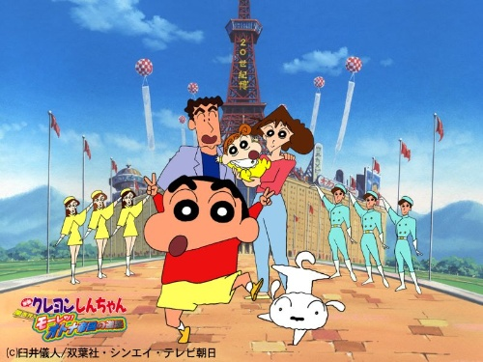
Crayon Shin-chan:
It is a Japanese manga series which follows the adventures of the five-year-old boy and his parents, baby sister, dog, neighbours, and friends.Maybe some stories in this manga are ridiculous (indeed all stories are ridiculous), but it has just aroused our interest.

Slide 9
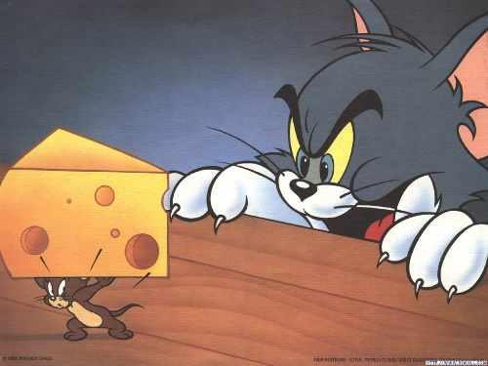
Tom and Jerry:
Tom and Jerry is an American animated series of short films created in 1940.When I see this film,I always hope the poor Tom could eat Jerry one day,but it never happen...

Slide 10
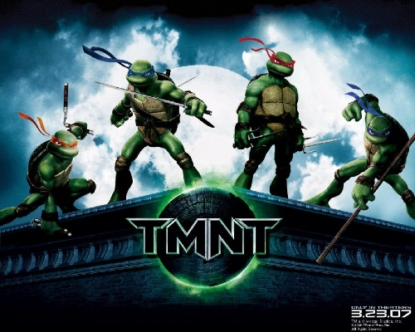
Ninja turtle:
It describes four skilled ninja turtles' inspired stories.But when we treat it serious,we find that they are just four turtles...

Slide 11
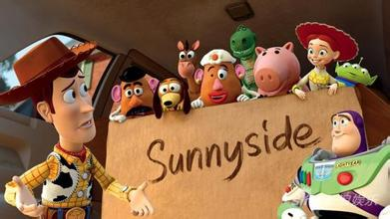
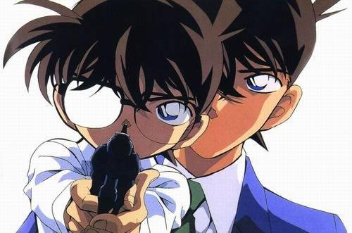
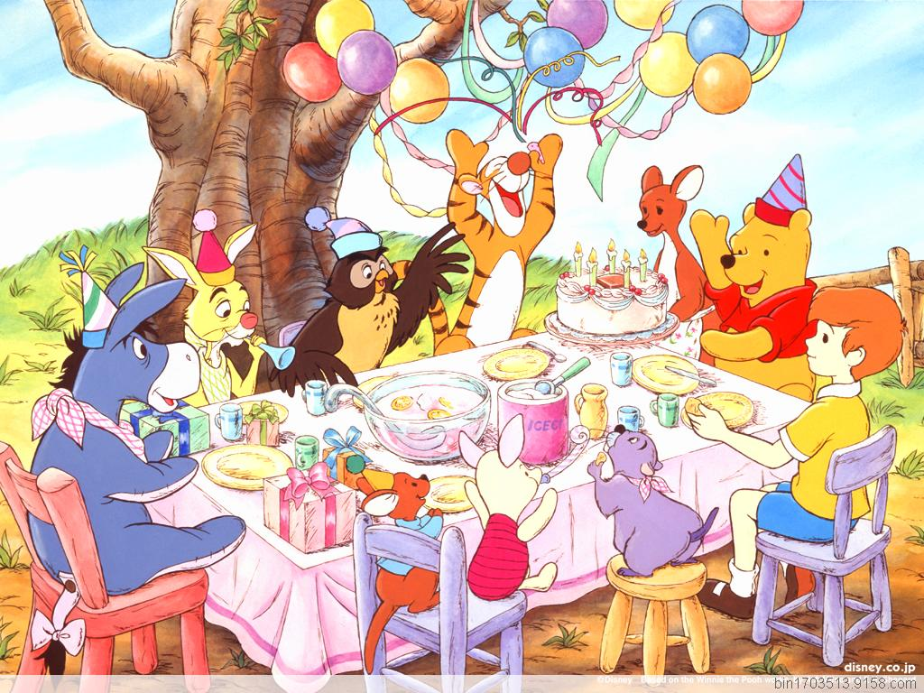
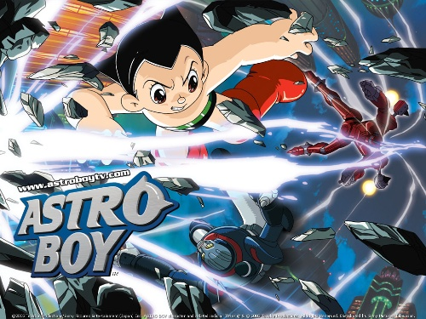

The Toy Story Series
Winnie the Pooh
Astro Boy

Slide 12
Some special toys and games

Slide 13
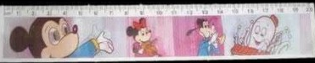
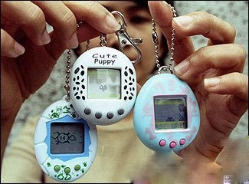
Special ruler:
Digital pet:
We also call it electronic pet.
It is a ruler which can change from one picture to anothor picture if you watch it at different angle.

Slide 14
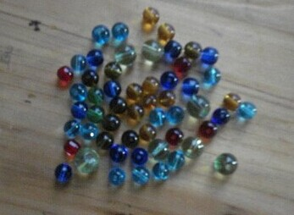
Hoodle（弹珠)：
It is popular in many people's childhood in the countryside.

Slide 15
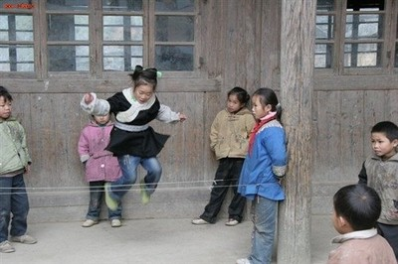
Skipping:
In my memory ,skipping is always the game designed for girls,sometimes there are also boys joining the games,but usually they just stand still.

Slide 16
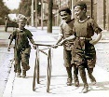
Hoop rolling:
Hoop rolling, also called hoop trundling, is both a sport and a child's game in which a large hoop is rolled along the ground, generally
by means of an implement wielded by the player. The aim of the game is to keep the hoop upright for long periods of time or to do various tricks.

Slide 17
Part 2

Slide 18
The popularization of knowledge
As we all know, 幼儿园 in English is kindergarten. But, what is the English name of
小班？
中二班？
&大大班？

Slide 19
Story about a famous person ——Washington

Slide 20
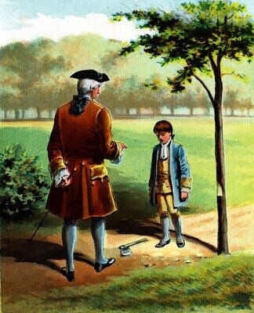
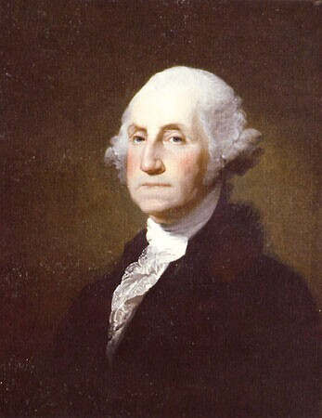

Slide 21
Part 3
My childlike heart will go on

Slide 22
How time flies!
brave
fearless
curiosity
trust
…

Slide 23
Thanks for watching!

Slide 24
This is …
Hongkang Hu
Back

Slide 25
This is …
Bo Liu
Back

Slide 26
This is …
Kimi

Slide 27
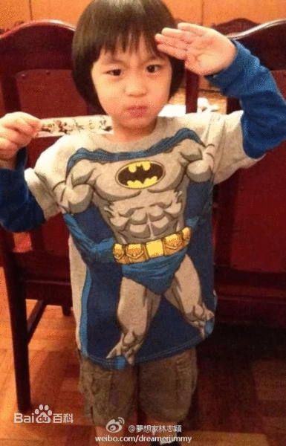
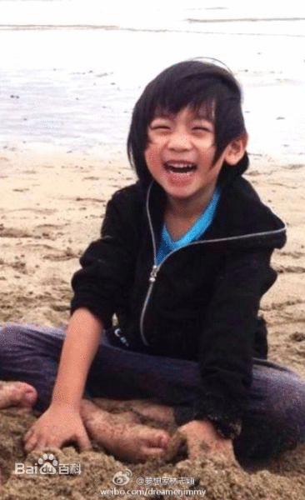
Kimi, born in Taiwan, is the son of the famous actor as well as singer, Jimmy Lin(林志颖). Kimi became famous for his cute appearance and naught character after he took part in a TV show, Dad Where going . Now, he is happily studying in a kindergarten though he is well-known.
Back

Slide 28
This is …
Yilong Cai
Back

Slide 29
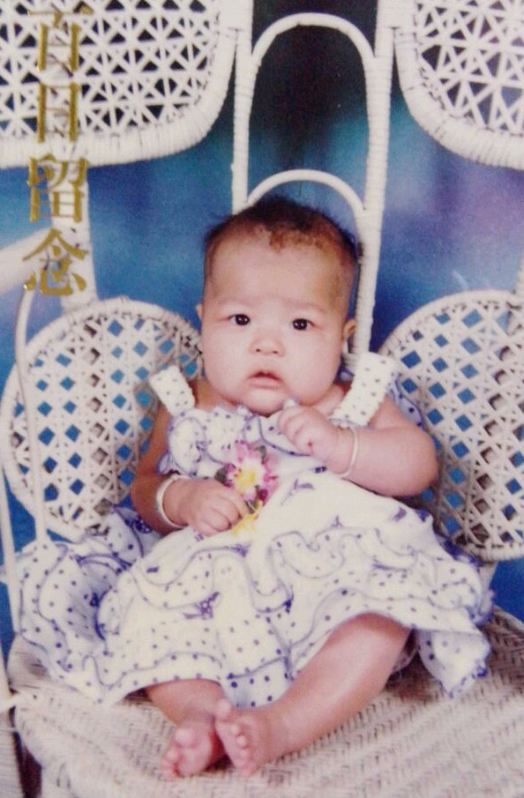
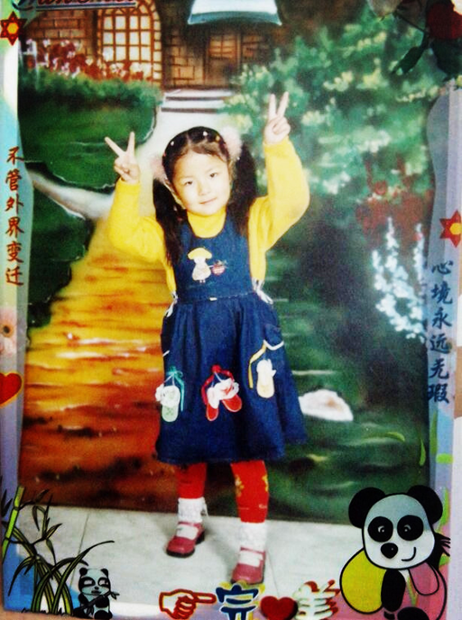
This is …
Yinshuang Bai
Back

Slide 30
This is …
Xiaojun Wang
Back

Slide 31
小班 is equal to is the bottom class in a kindergarten
Back

Slide 32
中二班 = middle shift class 2
大班 == the highest class in a kindergarten
Back

